Slide 1
Randomness, Unpredictability, Chaos
R. Garner, DePaul University

Slide 2

1750 clock: metaphor for God’s creation as deterministic

Slide 3
The Sciences
The universe as clockwork: God as a clockmaker (a popular image in the emergence of scientific thought during the 16th-18th centuries)
Tilt toward the deterministic side:
Laws of motion in physics
Genetics—DNA and the genome
Neuroscience
Marketing—understanding patterns of choices

Slide 4
Enter randomness (in applied stats)
We are especially interested in randomness associated with sampling error (variability in the outcomes of samples), for purposes of statistical inference.

Slide 5
The Central Limit Theorem
This type of randomness (any given sample outcome is unpredictable) is “tame” in the sense that the overall pattern is predictable:
Normal curve, mean of sample means = population mean, and the standard deviation of the sample means is the population standard deviation divided by the square root of sample size (bigger sample, less deviation).

Slide 6
In this type of randomness
Any given sample has an unpredictable outcome
The initial condition does not determine or influence the results
The process “has no memory”
BUT the overall pattern is predictable

Slide 7
Why was Tyche a sister of the Moerea (Fates)?
The Fates were the three hideous hags who spin, measure, and cut the thread of life.
All were children of Zeus and the Titaness Themis (“Law”)

Slide 8
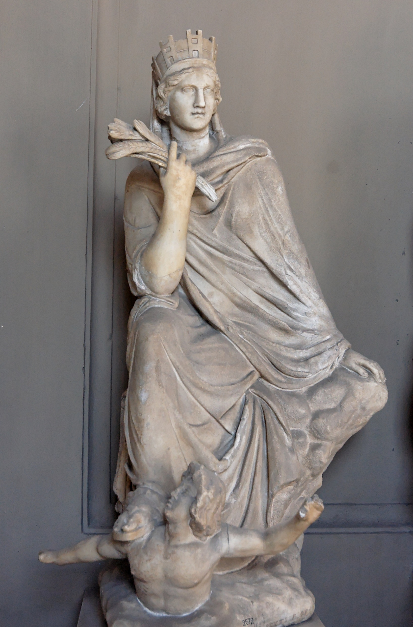
Tyche/Fortuna

Slide 9
This also applies to games
Roulette, poker (without bluffing!), coin flips, dice tosses, lotteries, etc.

Slide 10
But more can be said…
Even if something (volcano erupting, tornado, cancer onset, daily stock fluctuations) appears to be random—it is probably not random
It is just that we don’t know enough of the determining forces to predict it.
Random? Truly random or just lack of knowledge?
See NOVA: World’s deadliest volcanoes, etc.

Slide 11
Statistical determination
In statistical analysis, we can predict the overall pattern, but not each individual case.
Origins in analysis of gambling (17th century)
Emile Durkheim, Suicide
Mendelian genetics
Radioactive decay
Statistical techniques—e.g., correlation and regression analysis—developed and applied in biological sciences (e.g., fertilizer and crop yields, kids’ heights, etc.)

Slide 12
Stephen J. Gould and “contingency”
In Wonderful Life, Gould interprets data from the Burgess Shale (a rock formation in Canada with many fossils from 505 million years ago, after the Cambrian explosion) and argues that it was not clear that only the “fittest” survived. He emphasizes the role of chance and contingency, especially at points of rapid change—a controversial argument!

Slide 13

Burgess Shale critters

Slide 14
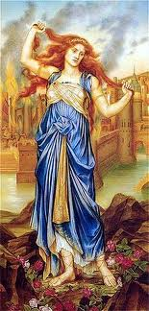
Cassandra
Cassandra was a priestess of Apollo. When she resisted the advances of the god, he placed a curse on her—although she always saw the future accurately, no one believed her.

Slide 15
Was it possible to predict…
The crash of 2008?
The Seahawks victory in the 2014 Super Bowl? Patriots in 2015?
World War II?
Trump’s victory in the 2016 presidential election?
The end of the Montreal Expos Major League Baseball team?
The grade—good or bad—you received on your paper?

Slide 16
“One-off” vs. overall pattern
Notice the events on the preceding slide are “one-off” events. Perhaps these are difficult to predict, but we can more easily predict overall patterns for lots of people (or lots of molecules or atoms).

Slide 17
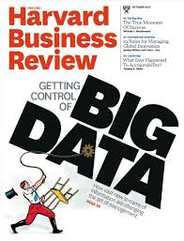
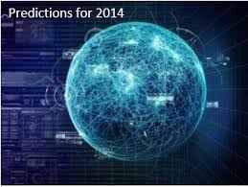
Big Data
How big is Big Data?
Can we predict everything now?

Slide 18
Quantum Physics
At the sub-atomic level, are processes genuinely random (probabilistic) or just determined by forces we do not understand?
Bohr and Heisenberg vs. Albert Einstein:
“I cannot believe that the Old One plays dice with the universe.”
Bohr and Heisenberg thought He/She/They did.

Slide 19

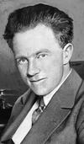

A probabilistic universe at the quantum level?
Einstein—rather not….
Heisenberg and Bohr—yes

Slide 20
Chaos Theory
Although they “sound alike”—chaos and randomness are actually very different.
In chaotic processes:
The past does determine the future.
Initial conditions matter.
Processes may be random at some stages and “flip” into deterministic patterns, or vice versa.

Slide 21
Examples of chaos theory
In weather forecasting (the butterfly in the Caribbean and the hurricane).
In hydrodynamics—the motion of water and other liquides.
Possibly in stock market fluctuation, though the random vs. chaotic debate has not been settled.

